Slide 1
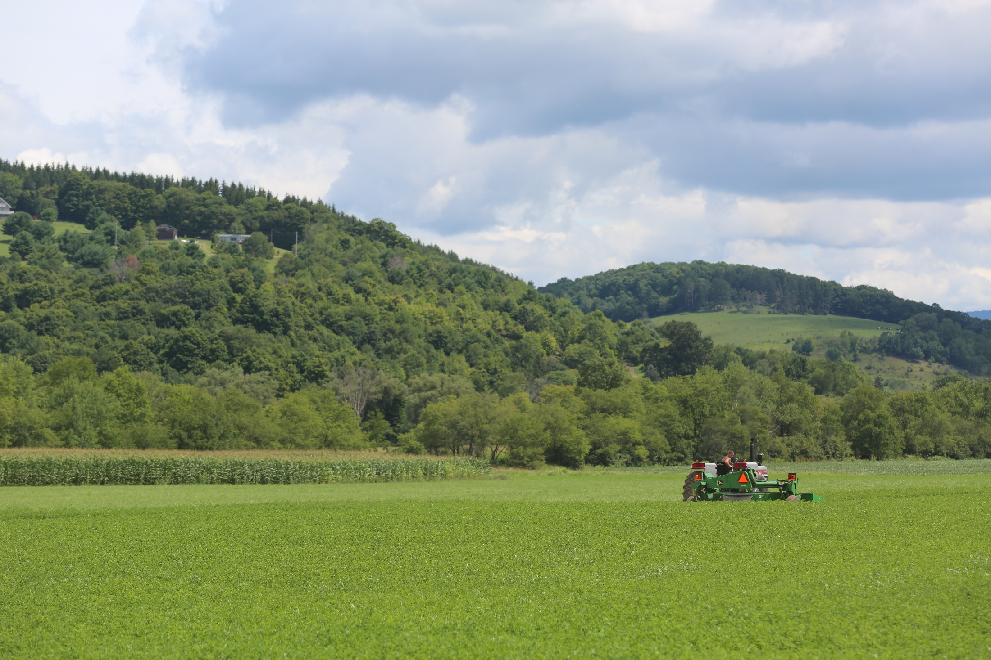
Cover Page: Title
Presenter Name, Title, Date
Include WAC logo on this page.
Title and logo can be Above, Below, or overlapping photo (can use different photo).

Slide 2
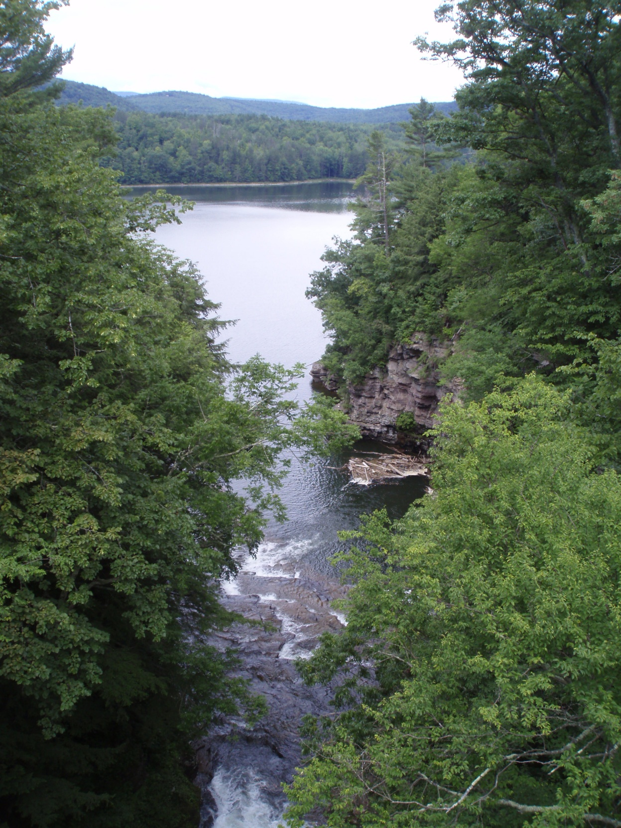
Section Header
Section subcategories or facts can be listed here.
This page is just an example, you can format photo and text as needed.
Color block can be removed from this page; it’s shown here as an example and to add some “pop” to the page.
Update with appropriate photo as needed.

Slide 3
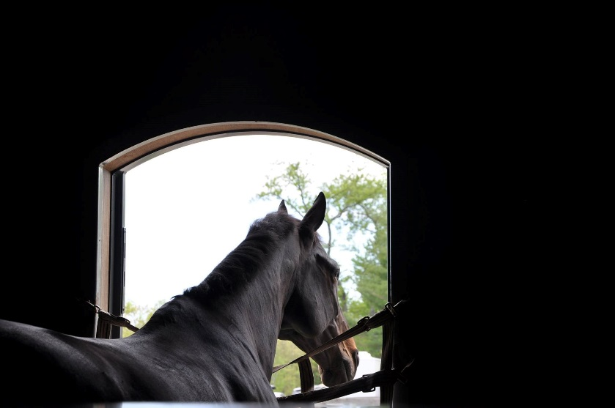
Subhead/Title (as needed)
Interior Pages
Color block can (but does not have to) coordinate with program color; color block can also be used as a footer. A color block is not necessary but can add a nice touch to selected slides.
Use simple bullets when needed, stay away from decorative bullets when possible.
Use Arial Font or Times New Roman, text should be black.
Use photos that relate to your topic, all text PowerPoints aren’t interesting to viewers. There doesn’t need to be a photo on every page, use your discretion.
DO NOT overlap photos, it looks messy and unorganized.
If you need help finding photos, contact the Communications Director or Outreach Specialist.
Include WAC logo on bottom of page, on the right side if possible.

Slide 4
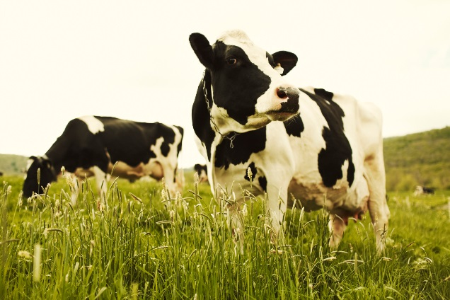
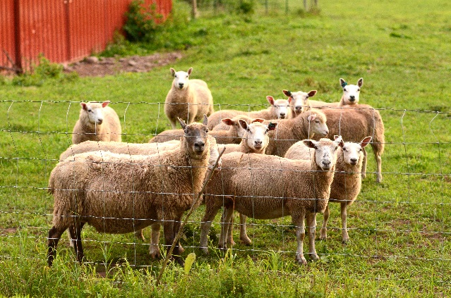
Interior Page Example #2
Here is another example of an interior page. Photos can be on either side of text (left or right), or on the top or bottom of the page. Throughout the presentation this layout can vary to keep viewers engaged. With the color block on the bottom of the page, the WAC logo with white text was used for readability.
Footer Variation

Slide 5
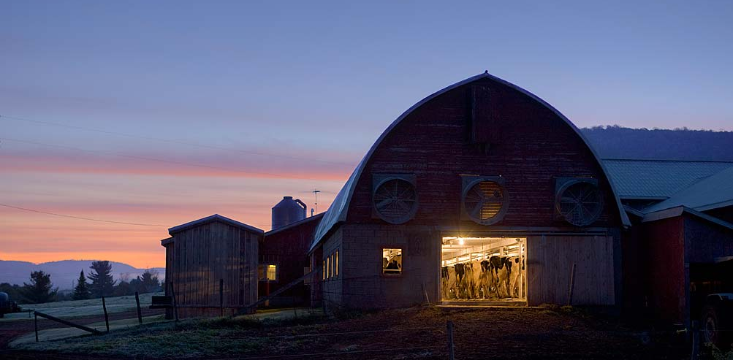
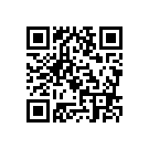
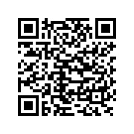
Last Page- Closing Message
Presenter Name, Title
Email
Phone number
(Photo can change- you can also update socials to program initiative, but must include WAC website)
Visit us online: nycwatershed.org
Android
Apple
Watershed Agricultural Council
@WaterFarmForest
@WaterFarmForest
WatershedAgCouncil

